Slide 1
Data analysis nano degree
Session 6
Conducted by hamza

Slide 2
Agenda
Linear regression
Logistic regression
Machine learning
Project

Slide 3
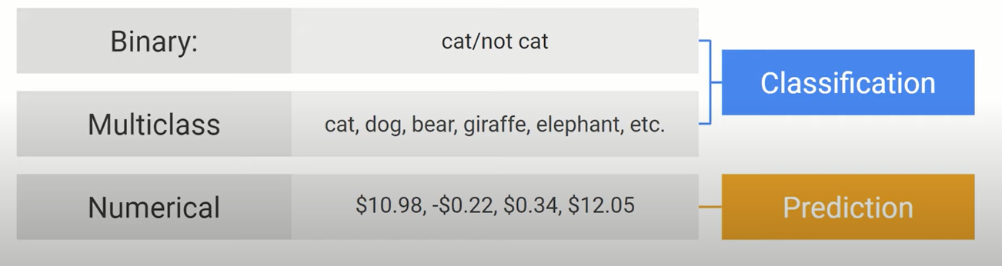
How to choose?

Slide 4

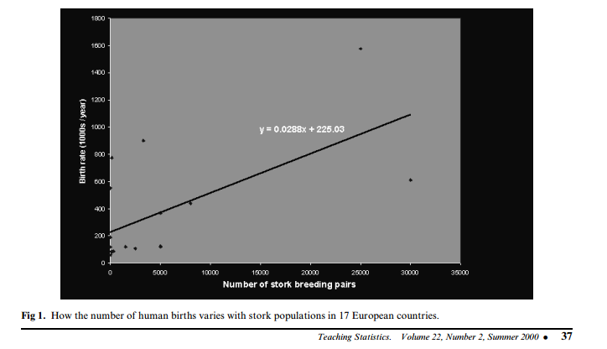
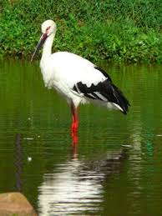
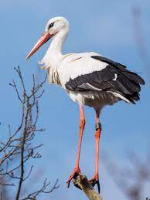
Storks Deliver Babies (p  0.008)
r = 0.62
Notes:
There is a high correlation between the number of storks in an area and the number of babies born. This was observed in the city of Copenhagen by looking at records of number of births and the number of storks over a 10-year period after World War II.1 It turns out that after the war, more people moved to Copenhagen (so more babies were born there) and more construction was going on in the city (so storks had more places, thus more storks).

Slide 5
Spurious correlations
http://www.tylervigen.com/spurious-correlations

Slide 6
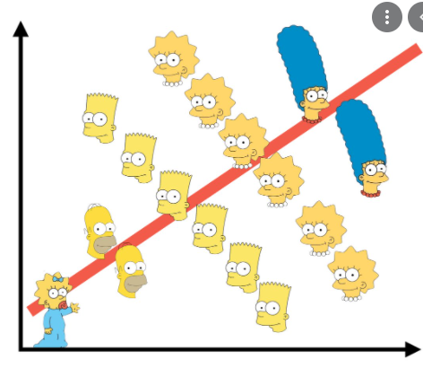
Simpsons paradox
How Can we solve it?

Slide 7
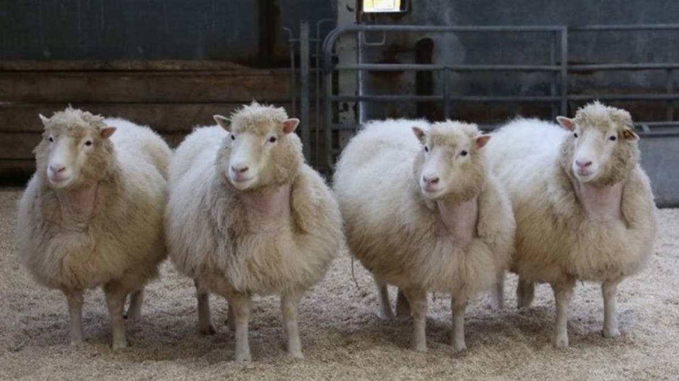
Randomization

Slide 8
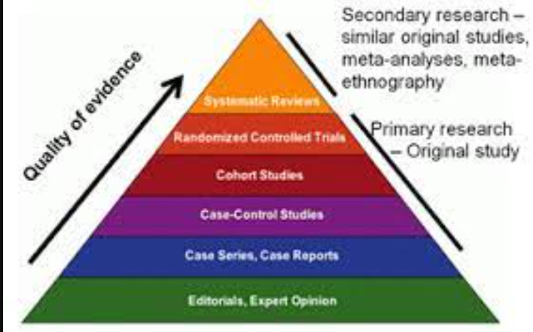
evidence

Slide 9
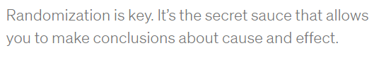
Cassie kozyrgov

Slide 10

Randomizaion Not always possible

Slide 11

Welcome to linear regression
A partial solution

Slide 12
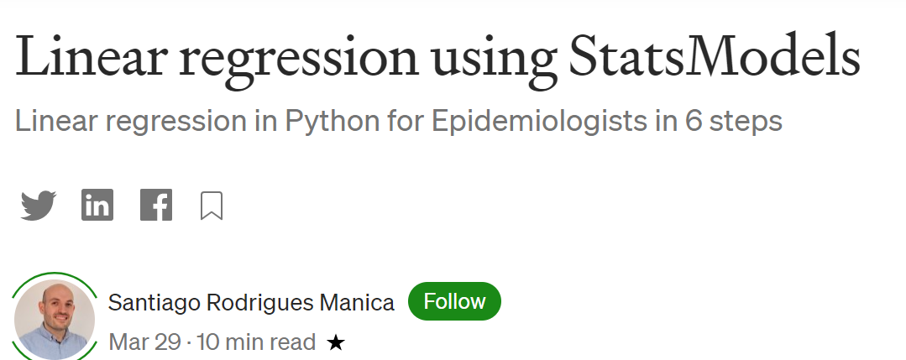
demo
Notes:
Linear regression using StatsModels | by Santiago Rodrigues Manica | EvidentEBM | Medium
https://medium.com/evidentebm/linear-regression-using-statsmodels-d0db5fef16bb

Slide 13
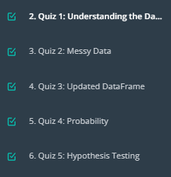
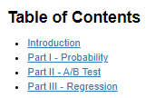
A/B testing Project

Slide 14
Part II - A/B Test
state your hypothesis

Slide 15
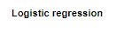
Part III - A regression approach

Slide 16
Breakout room1
https://campus.datacamp.com/courses/introduction-to-python-de9bedd8-983f-4a5b-a614-3d01d76e614e/67436?ex=1
Dataset description:
https://stat.ethz.ch/R-manual/R-devel/library/datasets/html/mtcars.html

Slide 17
Another point of view
Welcome to machine learning

Slide 18
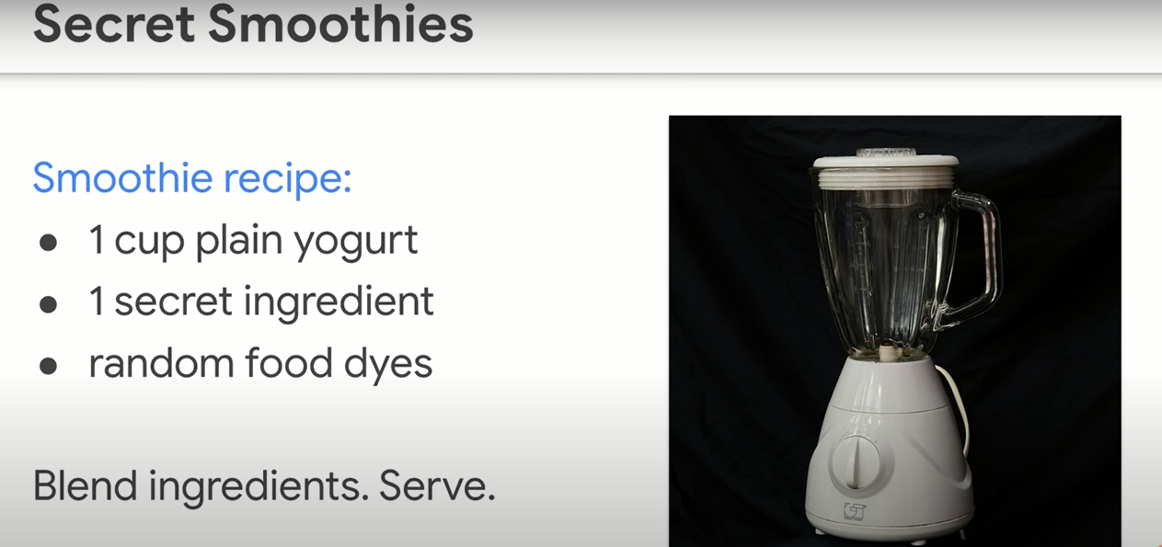
regression

Slide 19
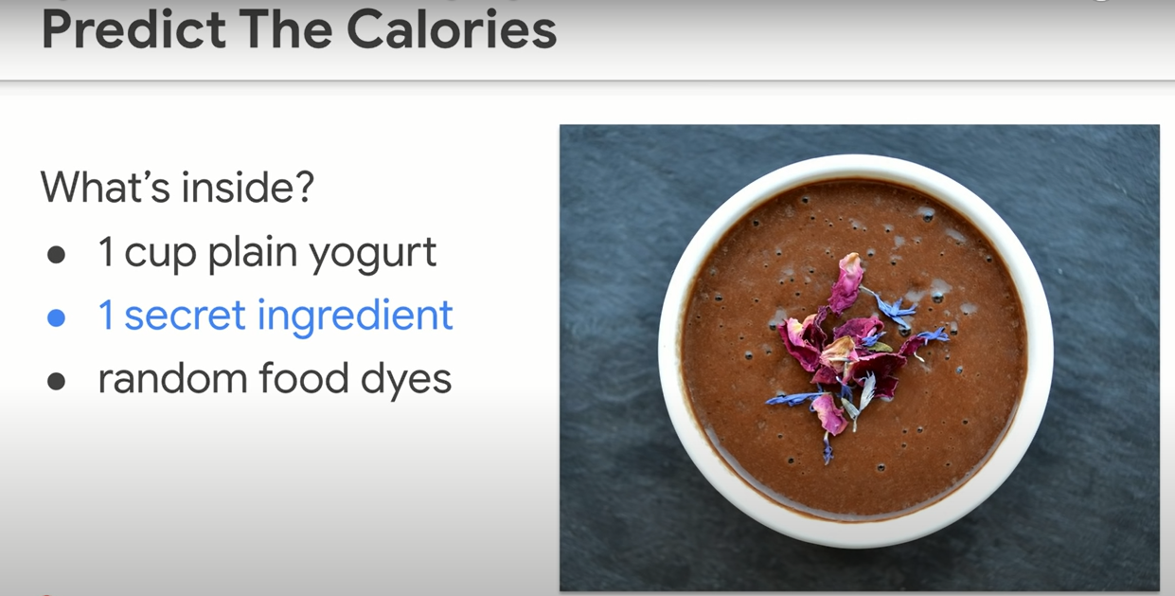
Guess!

Slide 20
Attitude of machine learning
Think carefully - perfectionism – get it right on the first shot
Give it a shot! – get it wrong – try again – ITERATE

Slide 21
Brave enough?
Let’s iterate …
Unlocking the next slide ☺

Slide 22
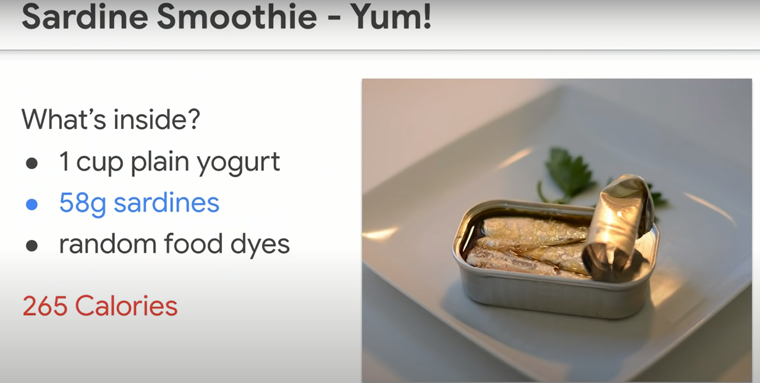

Slide 23
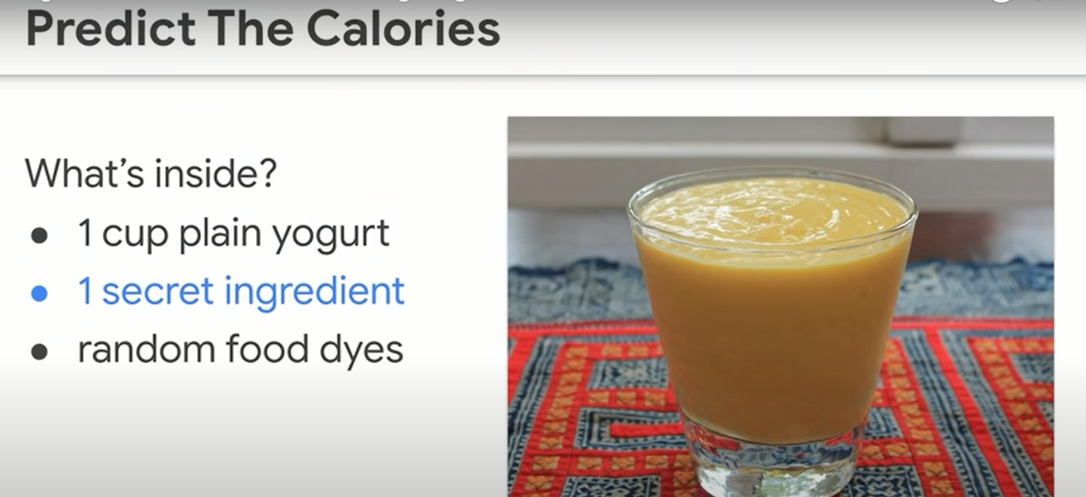
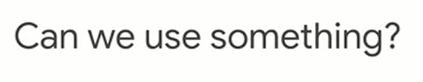
Notes:
We’ve been guessing based on no info
Can we have some info to guess based on ?

Slide 24
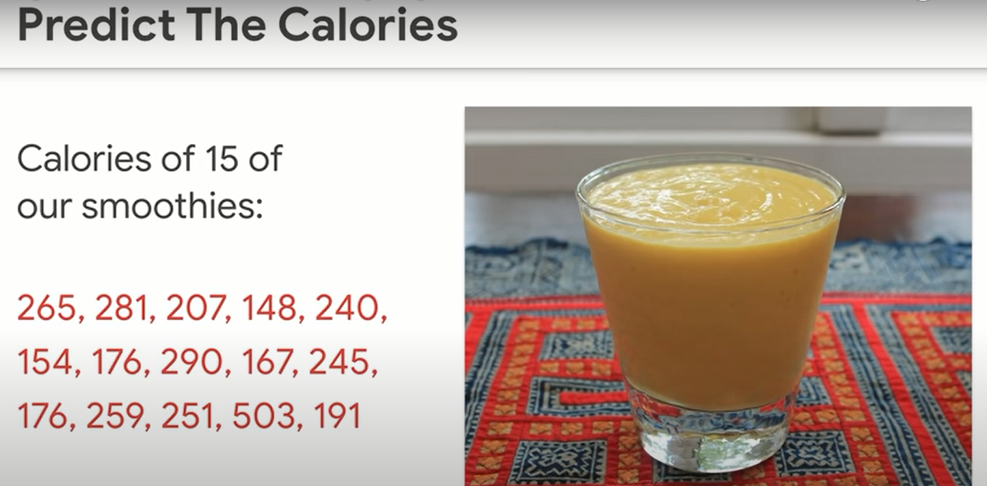
How to use the info?

Slide 25
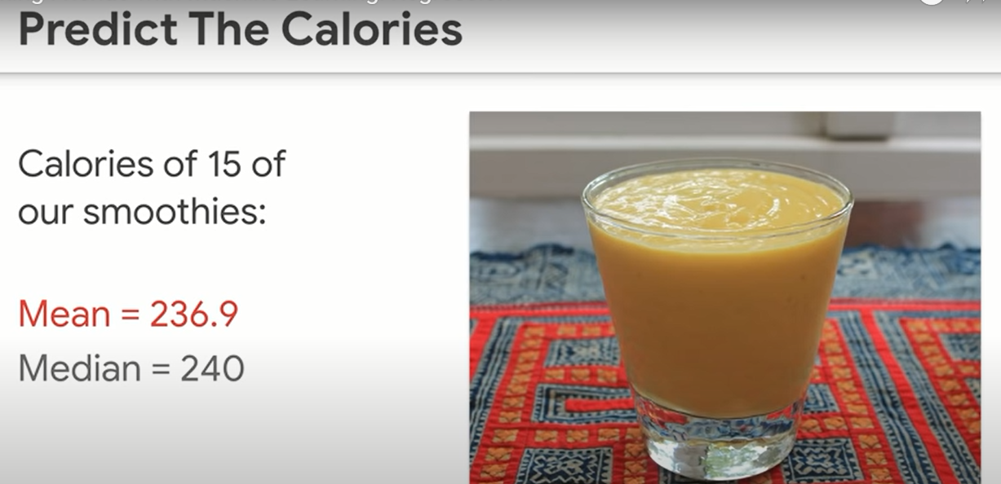
Guess now
Notes:
Notice how the guesses has narrowed now. Based on the new info

Slide 26
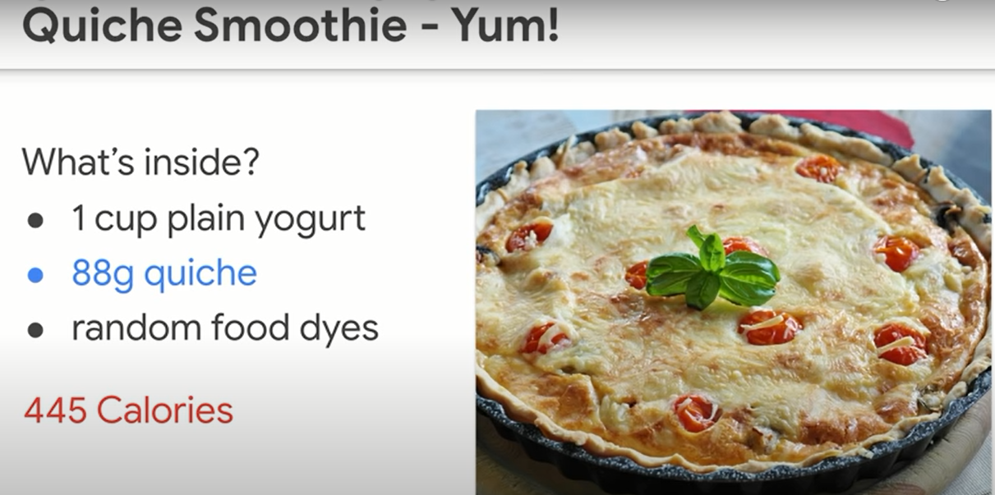
A bad guess ☹

Slide 27
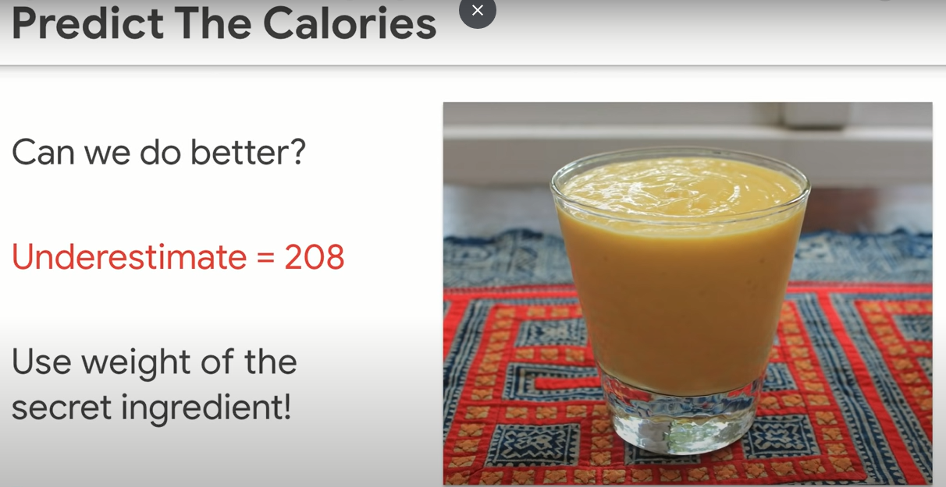

Slide 28
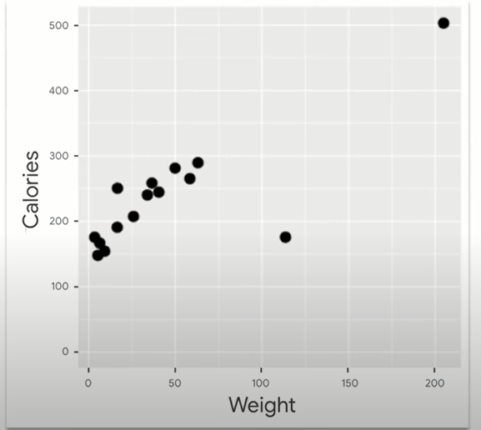
Is weight useful?

Slide 29
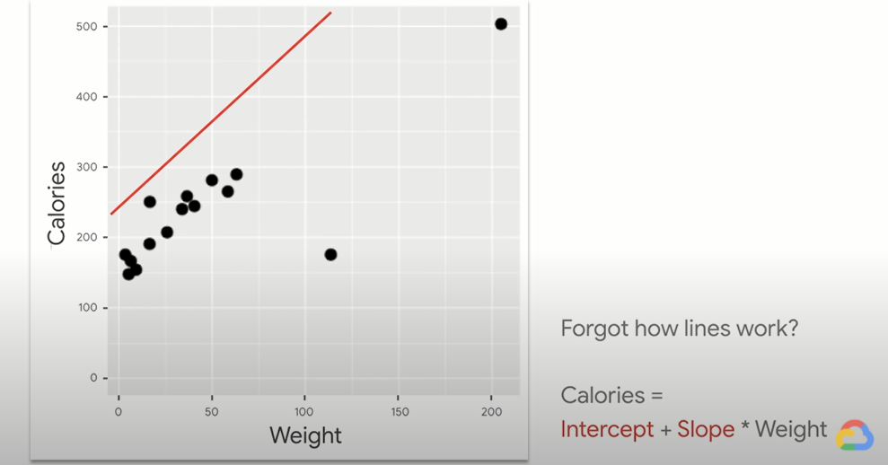
Regression: putting line through stuff

Slide 30
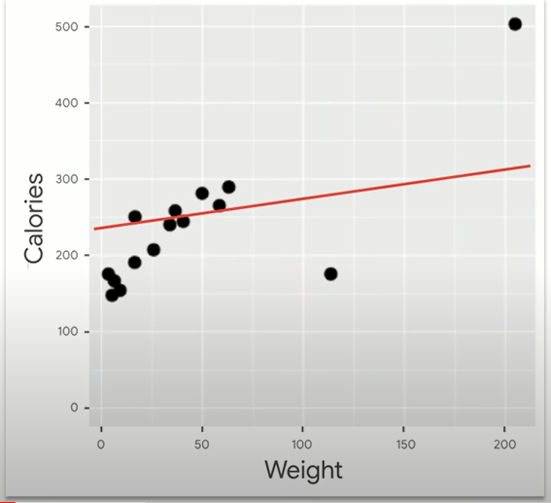
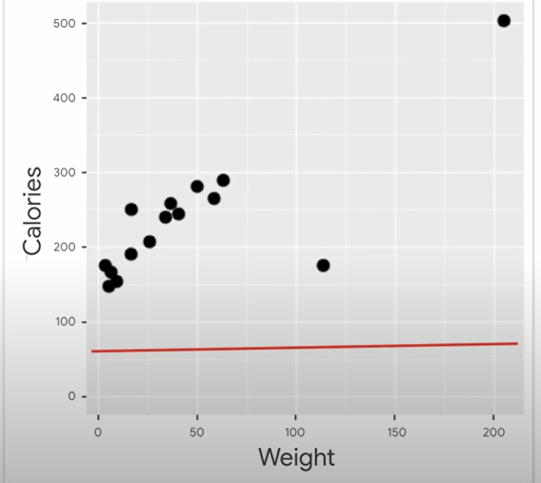

Slide 31
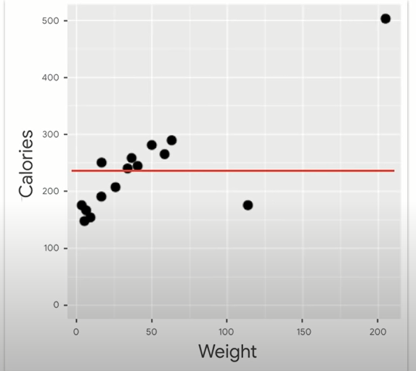
This one!
Why not?

Slide 32
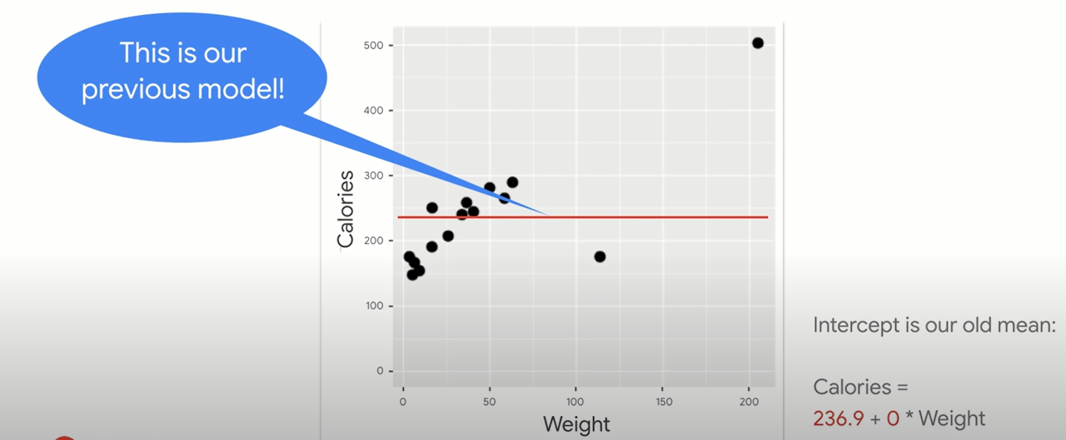
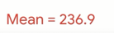
Weight is useless

Slide 33
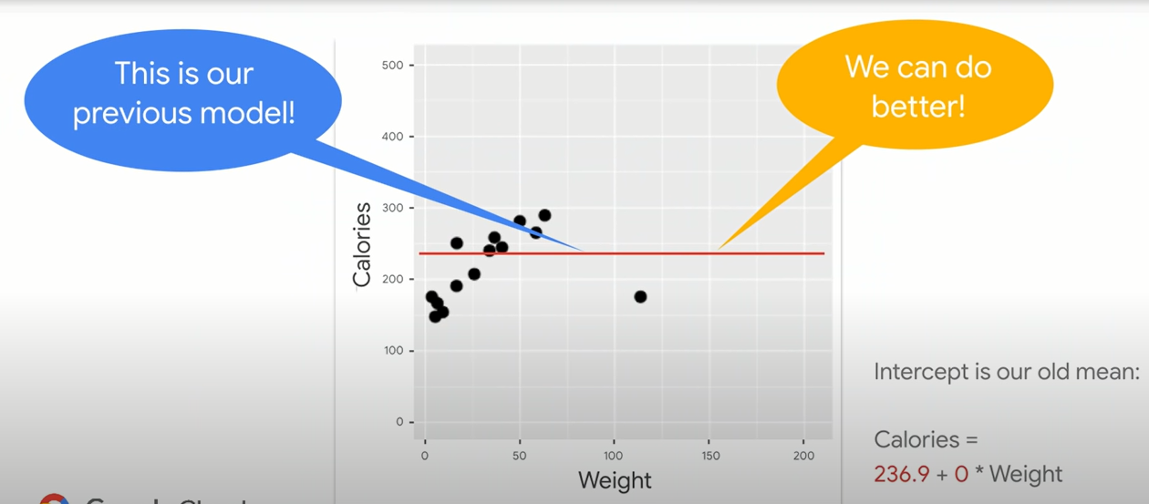
We have a feature

Slide 34
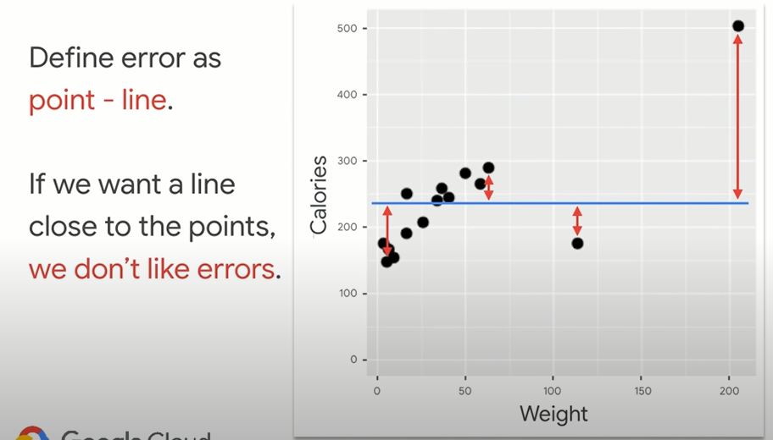
Notes:
RMSE = inversely named
Error, square it, Mean (take average), then root (sq root)

Slide 35
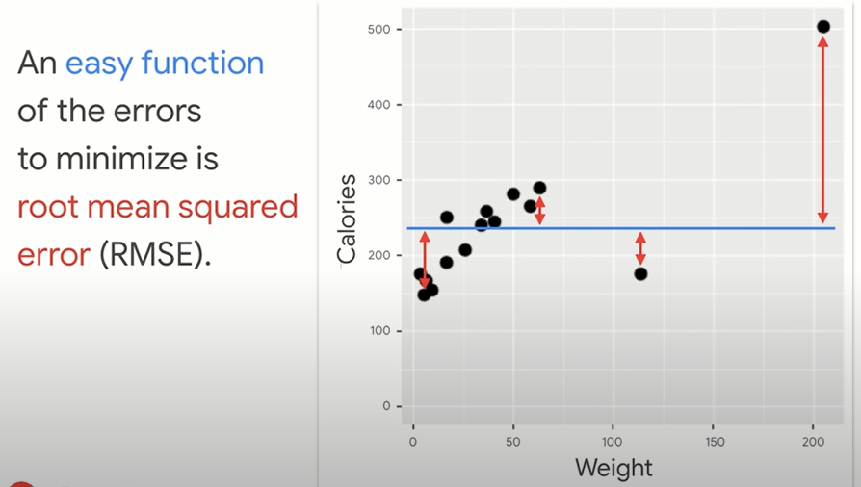
Best fit line?

Slide 36
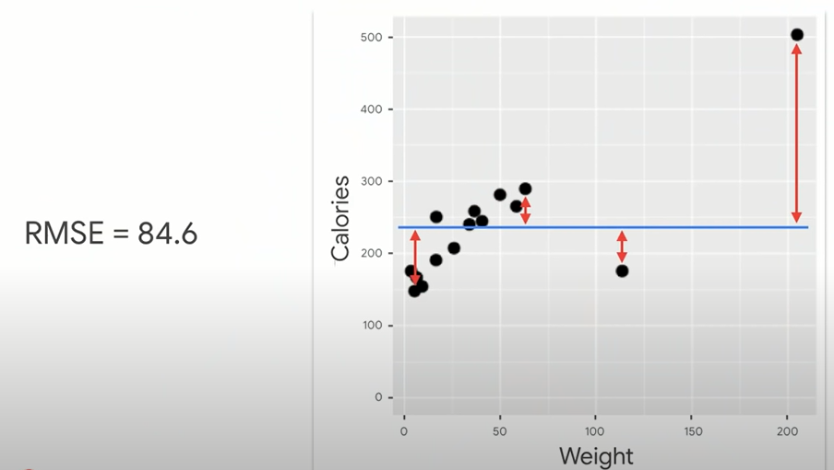

Slide 37
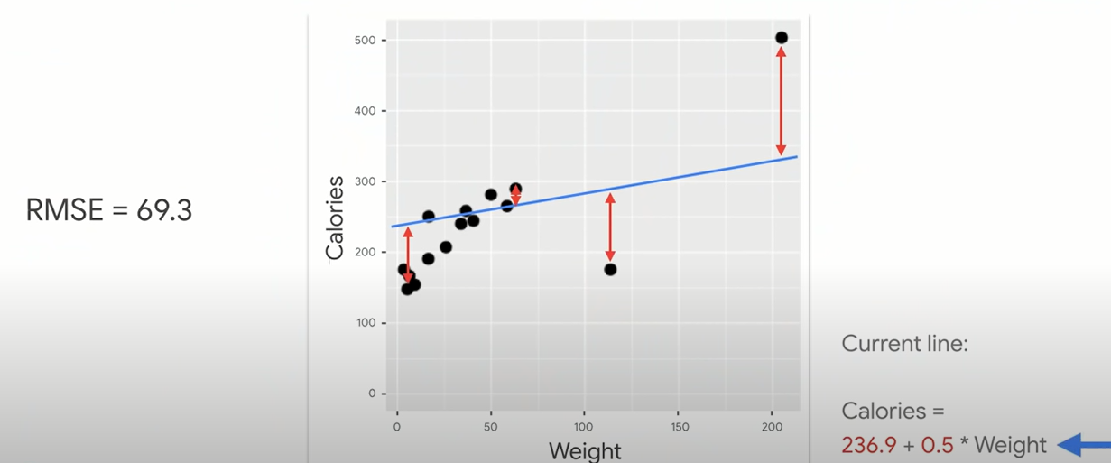

Slide 38
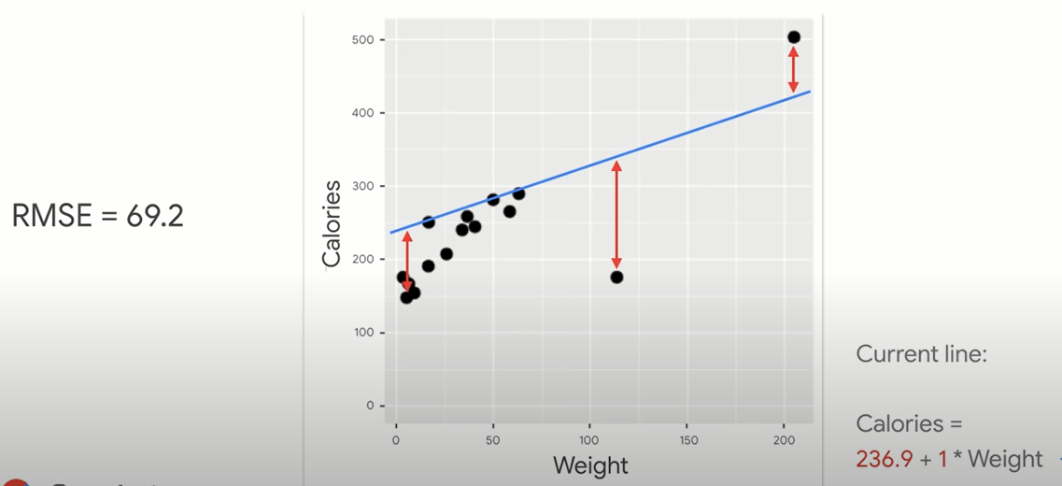

Slide 39
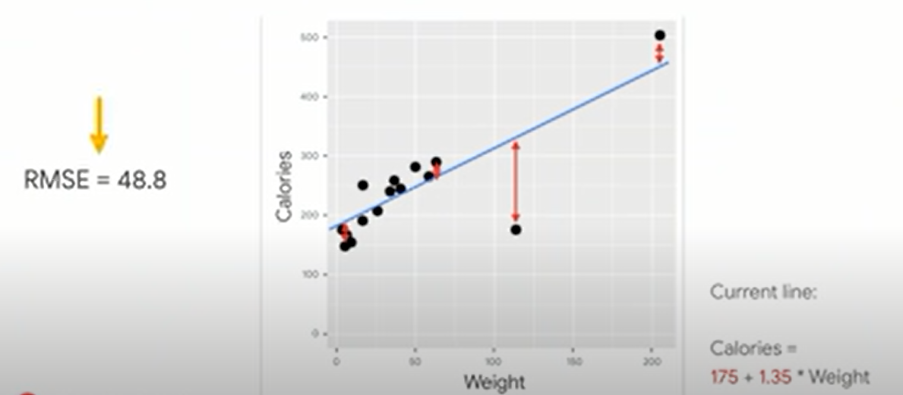

Slide 40
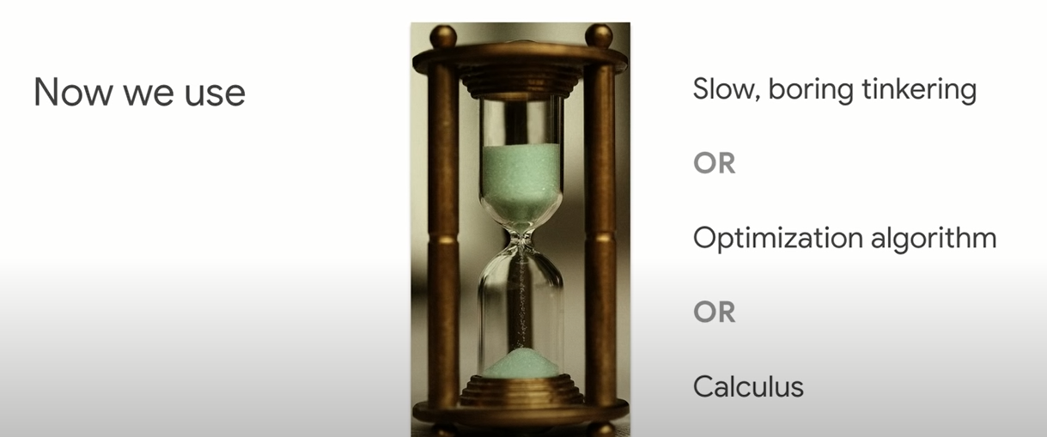

Slide 41
Heart of machine learning
Know ur score(eg. RMSE)
Play with parameters(intercept and slope) to minimize ur error

Slide 42
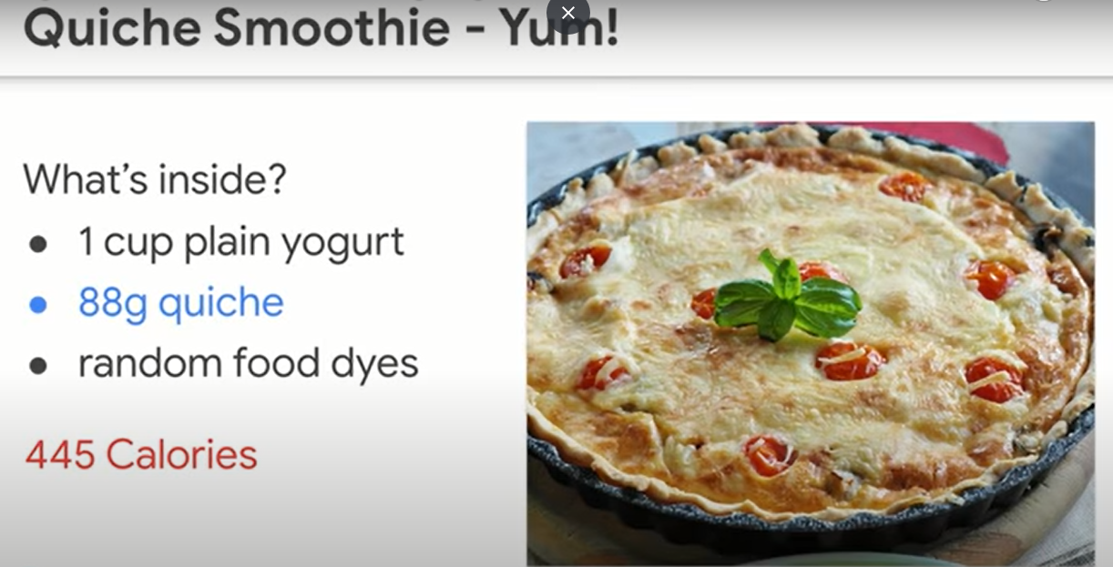

Slide 43
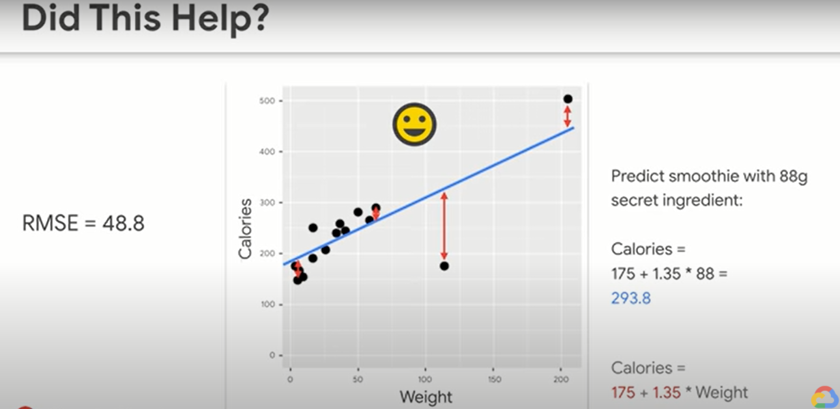
Not much

Slide 44
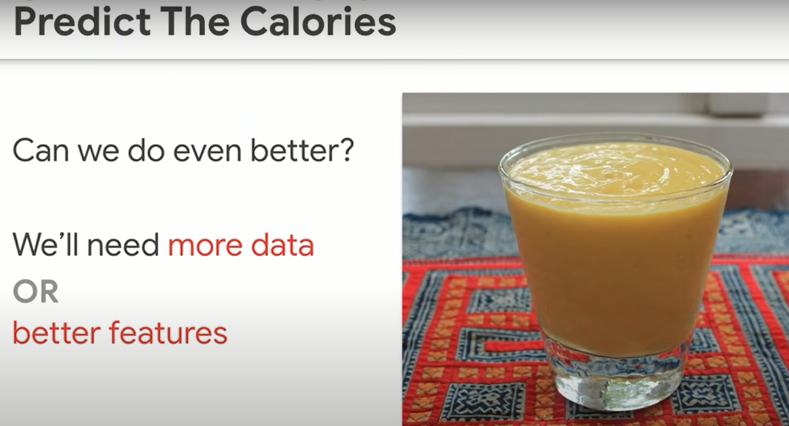

Slide 45
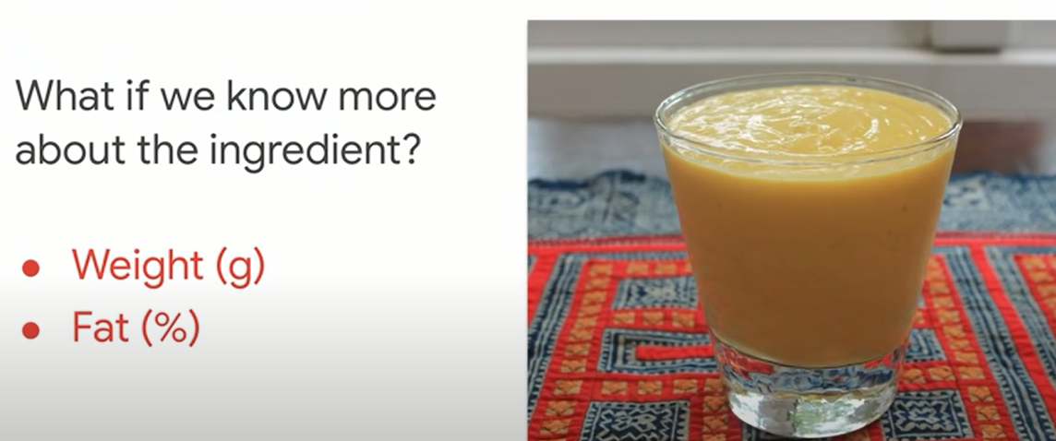

Slide 46
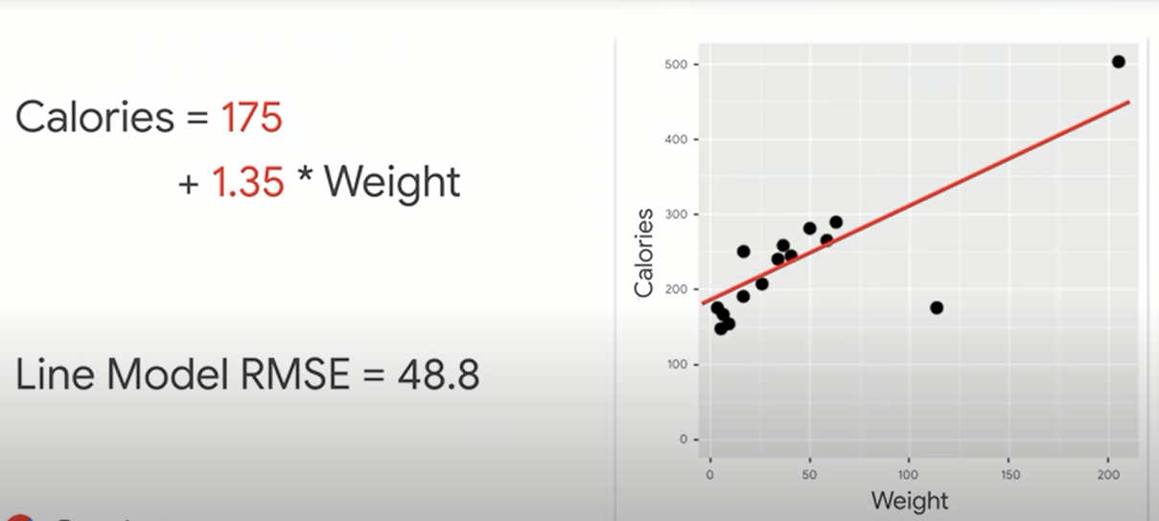
IT WAS A LINE
Statistics?
Notes:
In stats, we needed p values/ R sq adjusted R squared, etc….
Here… just optimize

Slide 47
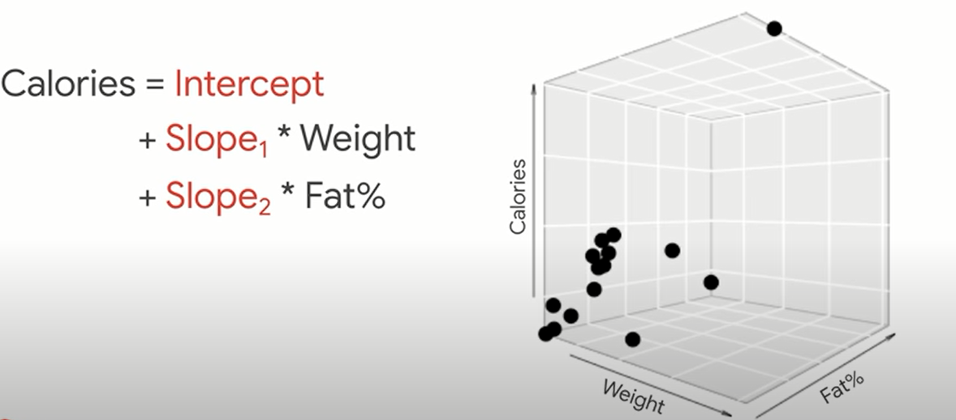
NOW A PLANE

Slide 48
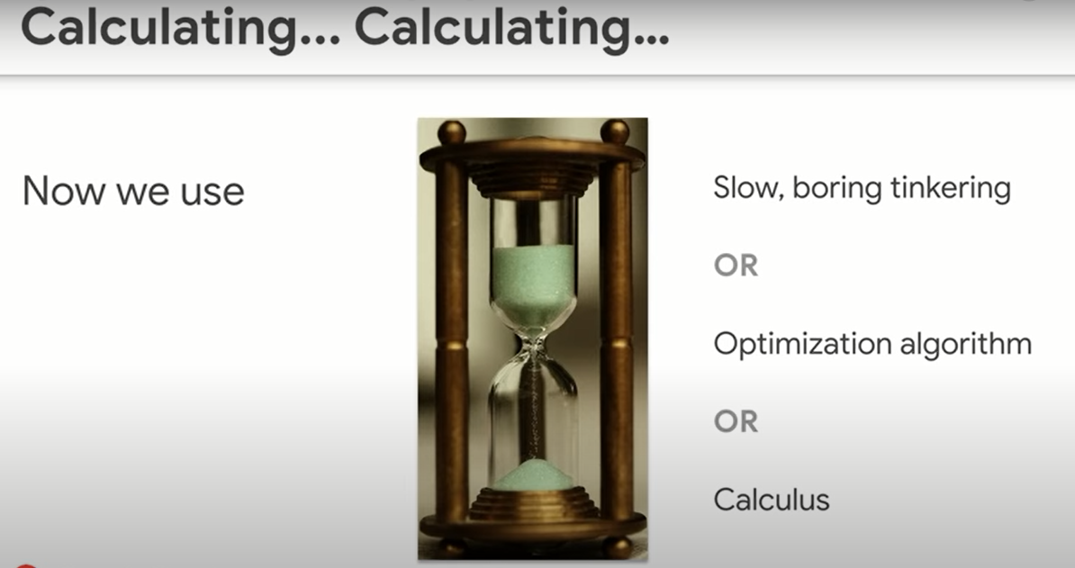

Slide 49
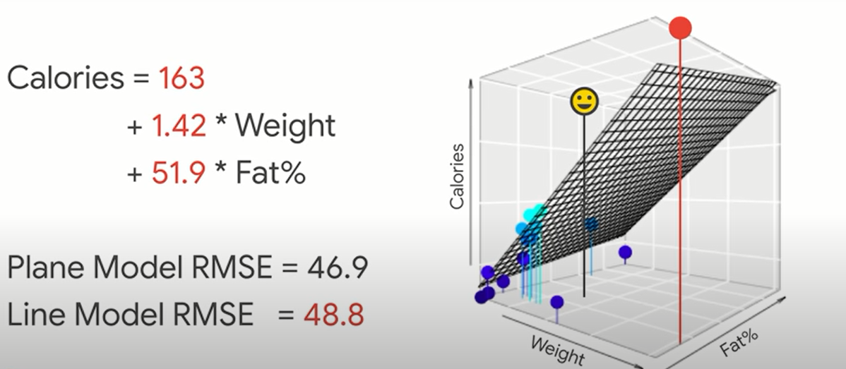
ENOUGH IMPROVEMENT?
Notes:
I added a new feature and I only get this improvement?

Slide 50
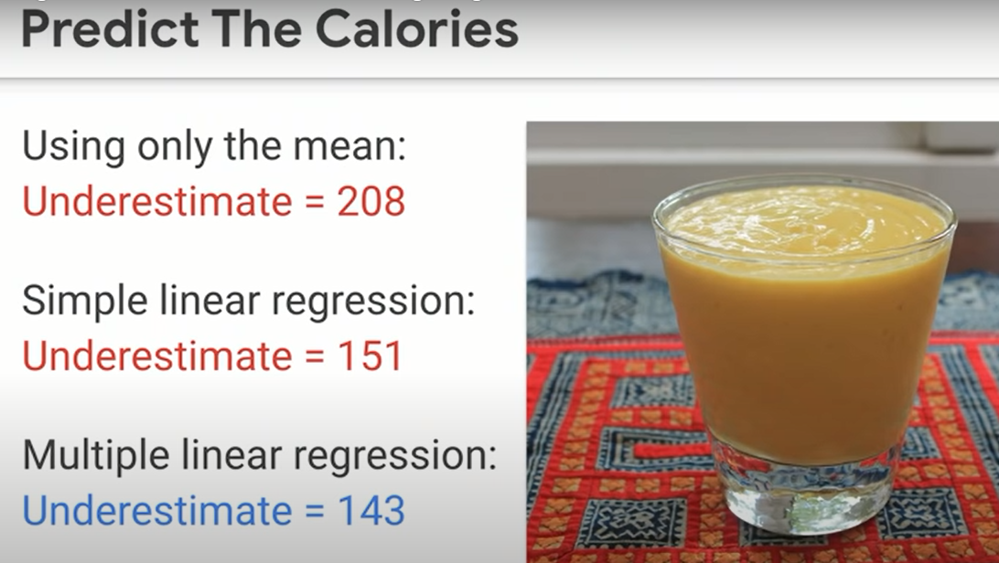

Slide 51
Machine learning pillar!
Does it take a long time to try it?
If No, then do it. Even if it’s not very justified
Notes:
That’s an essence in machine learning.

Slide 52
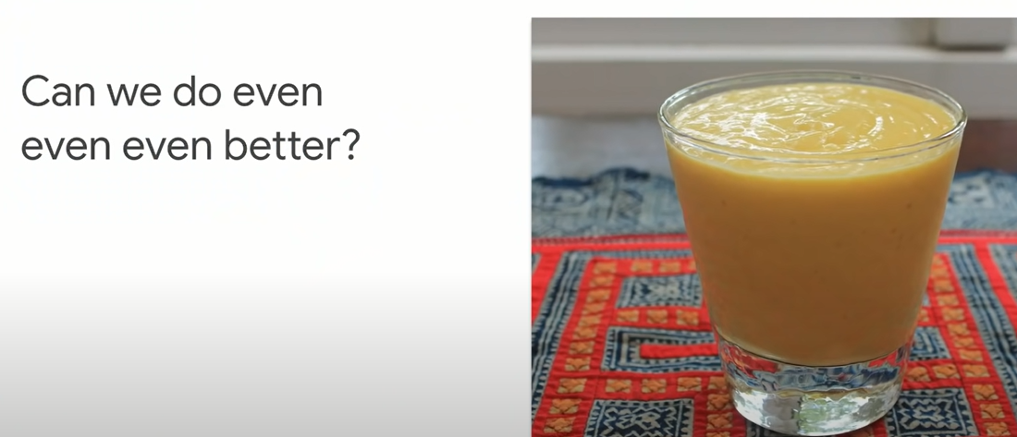

Slide 53
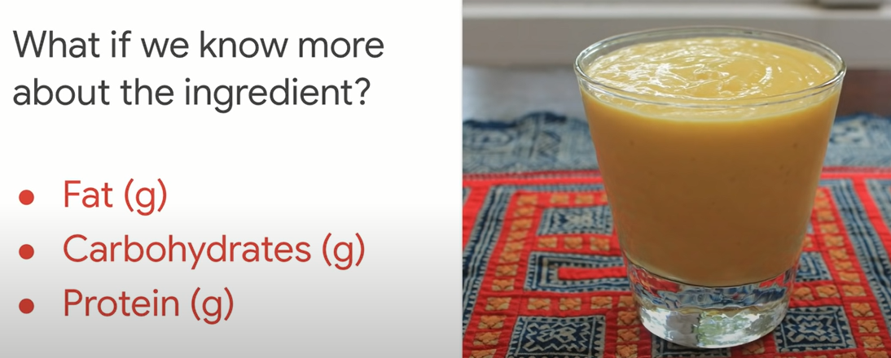
Any guesses?
Notes:
9:4:4
Magic numbers

Slide 54
9:4:4 nutrition rule
Notes:
9:4:4
Magic numbers

Slide 55
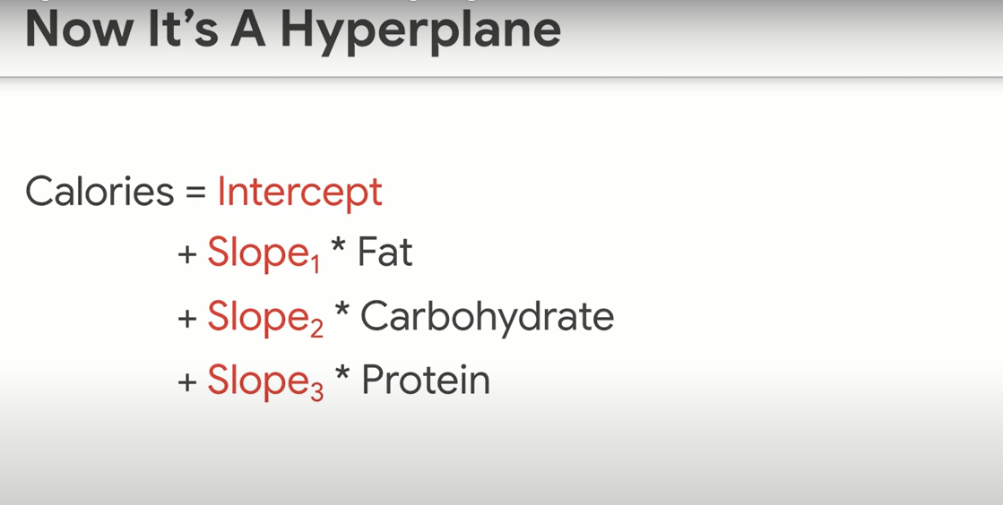

Slide 56
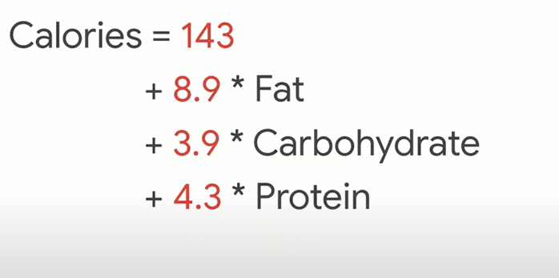
9:4:4

Slide 57
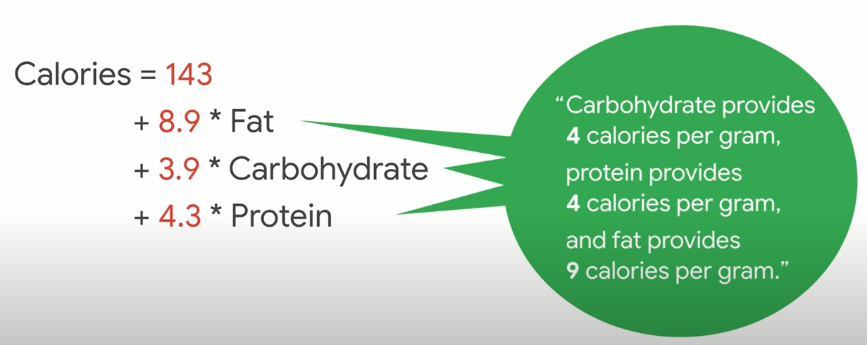
Feature engineering
What’s this 143?

Slide 58

Notes:
If we added water a secret ingredient
We get 143

Slide 59


Slide 60


Slide 61


Slide 62


Slide 63

Train – test - validate …
Notes:
As usual, our favorite bumbler forgot to buy the assigned textbook, but, luckily, he jotted down an equation from the blackboard (it’s the 90s) and now he’s got one night to learn enough to pass your exam. You’re his calculus prof in this story, by the way — I applaud your patience.

Slide 64

What he got..
No more examples [data points]
No explicit rules
Notes:
No explicit rules ( that’s the opposite of ML]
No other examples for ML to learn

Slide 65

Training
Notes:
Just like an AI algorithm, his goal is to find a data pattern that he can turn into a recipe (“model”) that successfully takes him from the input on the left of the “=” to the output on the right-hand side.

Slide 66

Found the pattern
Fits perfectly!
Go to exam?

Slide 67

Try another example!!
Notes:
That’s exactly what validation (step 8) in machine learning is. Validation creates a safe, low-stakes opportunity for students to try their recipes on examples they haven’t studied explicitly. That’s how they get a signal about whether they’re ready for the real exam.

Slide 68

More examples before exam
Notes:
(Mr. Bean is very lucky to have a professor like you. Thank you for sending him additional examples to try in the comfort and safety of his dorm room!)

Slide 69


Tries his model

Slide 70

What now?
start over
go to the exam anyway.
Notes:
12 Steps to Applied AI. A roadmap for every machine learning… | by Cassie Kozyrkov | The Startup | Medium
https://medium.com/swlh/12-steps-to-applied-ai-2fdad7fdcdf3
If he chooses to start over, he might go back to training (step 6) and search for new patterns in the data he already has (that single paltry datapoint) or he might go even further back and consider adjusting the data he’s working with (if it were me, I’d be begging you for a bunch of additional examples, which would mean going all the way back to step 2 in my guide).
Students (and ML/AI engineers) are allowed to bounce back and forth between looking for patterns and validating their new recipes as much as they like. (But don’t stay up all night studying!)

Slide 71

3 am
Notes:
Finally, at 3 AM, Mr. Bean found a pattern that works correctly on all the validation examples you’ve given him.

Slide 72

Notes:
You’re practically roaring, “Of course not!!!!”

Slide 73

Testing phase in ML/AI

Slide 74

Fits perfectly!
Notes:
For all you know, he might have hacked together a crazy recipe that overfits, er, contorts itself to fit those specific examples he has been staring at all night. Perhaps he has just memorized all the answers and that’s his recipe — looking them up from memory. There’s no guarantee he understands anything general enough to handle new problems.

Slide 75

No trust
How well he performs on new tasks

Slide 76

Notes:
So, is Mr. Bean’s best good enough? Should you give him a pass to go on to the next step (where you productionize him for mathematics in the wild) or should you delicately suggest he switch majors?

Slide 77

Fails on testing? Game over…

Slide 78

Notes:
Training, validation, and test phases in AI — explained in a way you’ll never forget | by Cassie Kozyrkov | Towards Data Science
https://towardsdatascience.com/training-validation-and-test-phases-in-ai-explained-in-a-way-youll-never-forget-744be50154e8

Slide 79



Notes:
If all you care about is failing unworthy students, you don’t need a validation phase. All you need is testing. Poor Mr. Bean trains, finds a pattern (it was a stupid pattern), rushes to your exam, fails the exam, and gets kicked out of the math major. You caught and executed an ignoramus. Great job!

Slide 80
Testing: Only the worthy should pass!
What about helping students to improve?

Slide 81
Testing: Only the worthy should pass!
Validation: helping students improve

Slide 82

The question
Notes:
If you really care about your students, it would be sad to find out that their attempts at a recipe are silly only after it’s too late to help them. (On the final exam itself.) What are you, a teacher or an executioner?

Slide 83

Notes:
How to be an AI idiot. 7 ways to royally mess up your machine… | by Cassie Kozyrkov | Towards Data Science
https://towardsdatascience.com/how-to-be-an-ai-idiot-8559c65d91a8

Slide 84
Breakout room 2
https://learn.datacamp.com/projects/558

Slide 85
Shiny experience
https://gallery.shinyapps.io/simple_regression/

